Slide 1

PyCaret Integration with Power BI
May 30, 2020

Slide 2
Key Links
https://www.pycaret.org
https://www.github.com/pycaret/pycaret
https://www.linkedin.com/in/profile-moez/
Repo’s
https://github.com/pycaret/pycaret-deployment-powerbi
https://www.github.com/pycaret/powerbi-anomaly-detection
https://www.github.com/pycaret/powerbi-clustering

Slide 3
What do you need to follow along?
Anaconda Distribution with Python 3.6 or greater.
Download: https://www.anaconda.com/products/individual
Power BI Desktop (I am using May 2020 release)
Download https://powerbi.microsoft.com/en-us/downloads/
PyCaret
Install https://www.pycaret.org/install

Slide 4
Create Environment and Install PyCaret
conda create –name powerbi python=3.7
conda activate powerbi
pip install pycaret
https://www.pycaret.org/install

Slide 5
How to? theoretically
Power BI and almost any other tool out there gives ability to execute Python / R scripts.
PyCaret has magic functions that supports execution of ML package into these tools.
Ideally, it is best to implement in ETL pipeline such as Power Query, Alteryx, KNIME, Informatica, SQL Server etc.
Use for batch processing.

Slide 6
Read more
Machine Learning in Power BI using PyCaret https://towardsdatascience.com/machine-learning-in-power-bi-using-pycaret-34307f09394a
Build your first Anomaly Detector in Power BI using PyCaret https://towardsdatascience.com/build-your-first-anomaly-detector-in-power-bi-using-pycaret-2b41b363244e
How to implement Clustering in Power BI using PyCaret https://towardsdatascience.com/how-to-implement-clustering-in-power-bi-using-pycaret-4b5e34b1405b
Machine Learning in Power BI using PyCaret https://towardsdatascience.com/machine-learning-in-power-bi-using-pycaret-34307f09394a

Slide 7
Read more (cont.)
Machine Learning in Tableau with PyCaret https://towardsdatascience.com/machine-learning-in-tableau-with-pycaret-166ffac9b22e
Machine Learning in SQL using PyCaret https://towardsdatascience.com/machine-learning-in-sql-using-pycaret-87aff377d90c

Slide 8
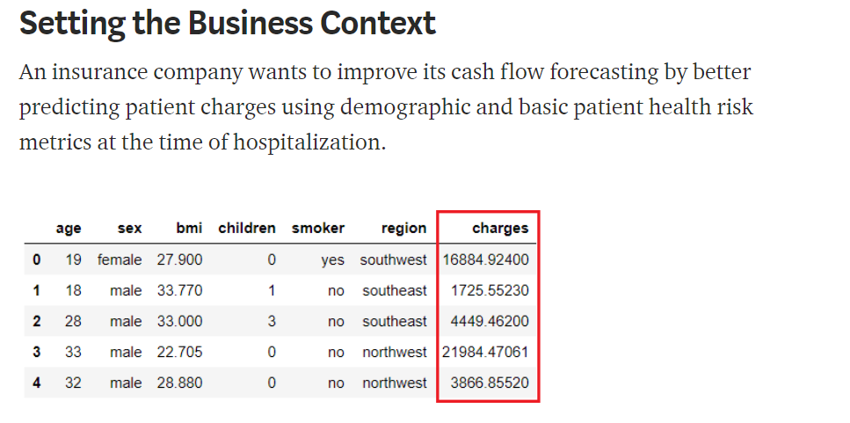
Demo # 1 – ABC Insurance Company

Slide 9
Workflow
Batch
Prediction
Training
Dataset
Model Training IDE/Notebook
Save Pipeline for deployment
Real time Predictions

Slide 10
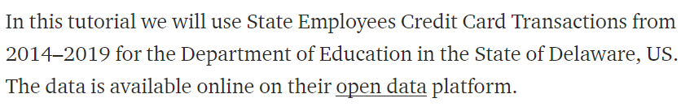
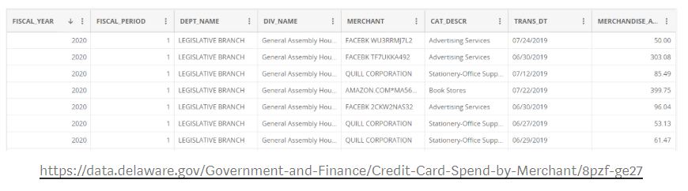
Demo # 2 – Dept of Education – State of Delaware, US

Slide 11
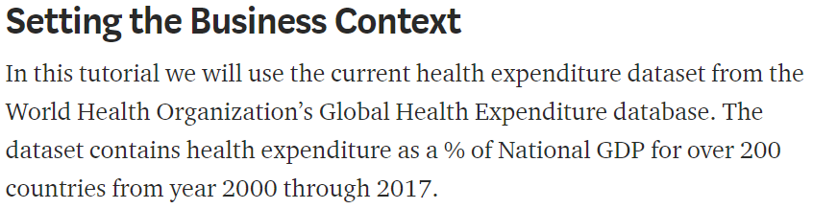
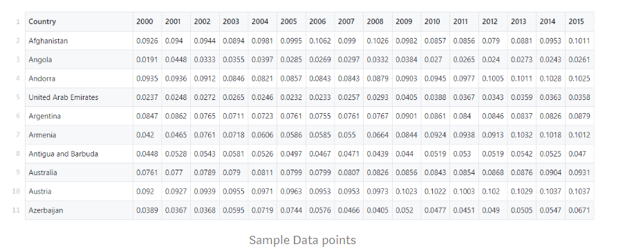
Demo # 3 – WHO Global Health Expenditure Database

